Slide 1

OMIS 665 – Bigdata Analytics for Business
Team-F
Vijeta Mishra
Vijayalakshmi Prasanna Maddula
Aditi Patel
Behrooz Alipoor
Zachary Wurst
Professor: Biagio Palese

Slide 2

Presentation Overview
US Accidents Introduction
Objective / Research questions
Analysis
Conclusion
This Photo by Unknown author is licensed under CC BY-NC.

Slide 3
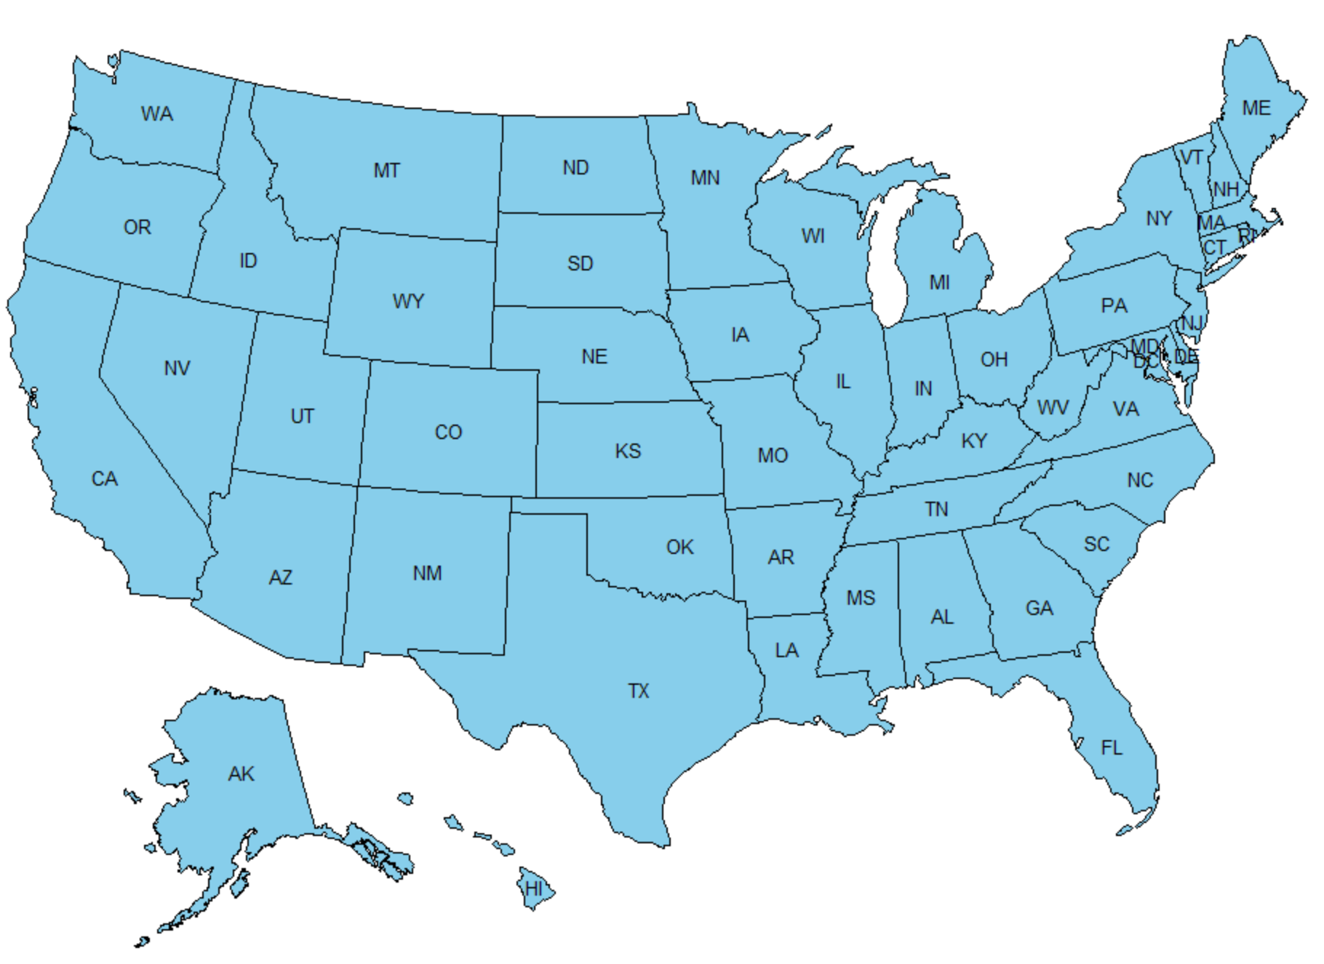
USA States

Slide 4
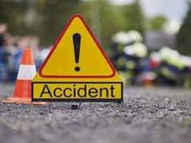
Introduction
Road accidents have become very common in recent years, Every year, over 38000 people die in road accidents in the United States.
Our objective of the project is to analyze and investigate the factors contributing accidents.
We have used
Bar graphs, donut chart, histogram, line chart, map
Correlation
K-means clustering, Linear and Multiple Regression
Source- https://www.asirt.org/safe-travel/road-safety-facts/
Image source: Timesofindia

Slide 5
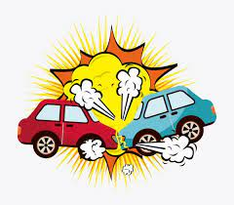
Research Questions
We will try to find the trend of accident and the factors effecting accidents.
We will also analyze the details of US Accidents in different states to be able to check what can be done to reduce accidents and additionally to avoid its effect on road traffic.
Image source : Depositphotos.com

Slide 6
Data Set Information
Source of Data set: KAGGLE
This is a country wide traffic accident data-set which covers 48 states of the US.
There are about 4.2 million accident records in this dataset. It contains all sort of information related to each accident.
There are a total of 49 Columns, such as air pressure, wind chill, precipitation, states, cities etc.

Slide 7
Data Preprocessing
Sampling the Data
Since this is huge dataset to analyze as R is taking time to process huge dataset, we decided to sample dataset, since it is easier for us to analyze. The new data-set will contain 1 million rows
Tidying the Data
Null values
Format of the Dates
Removed few columns since they have multiple values which is breaking rule number 3 of tidy data for example zip code which are not required for analysis.

Slide 8
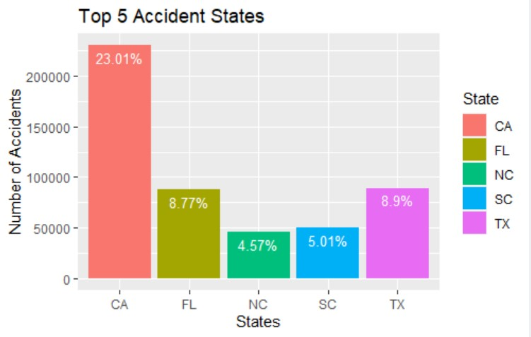
Top 5 accident states in USA
California has highest number of accidents with almost 23% of all accidents in USA.
Texas with approximately 9% of the total number of accidents. It would be interesting to know what factors contribute sharp decline in number of accidents in Texas considering that TX is twice the size of CA.

Slide 9
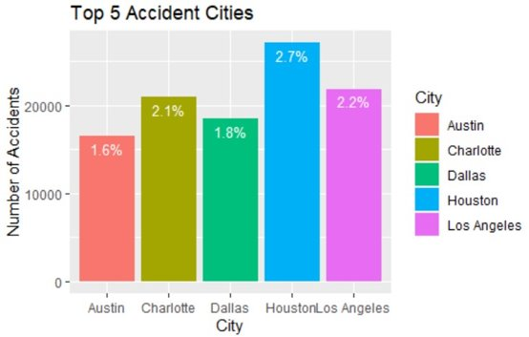
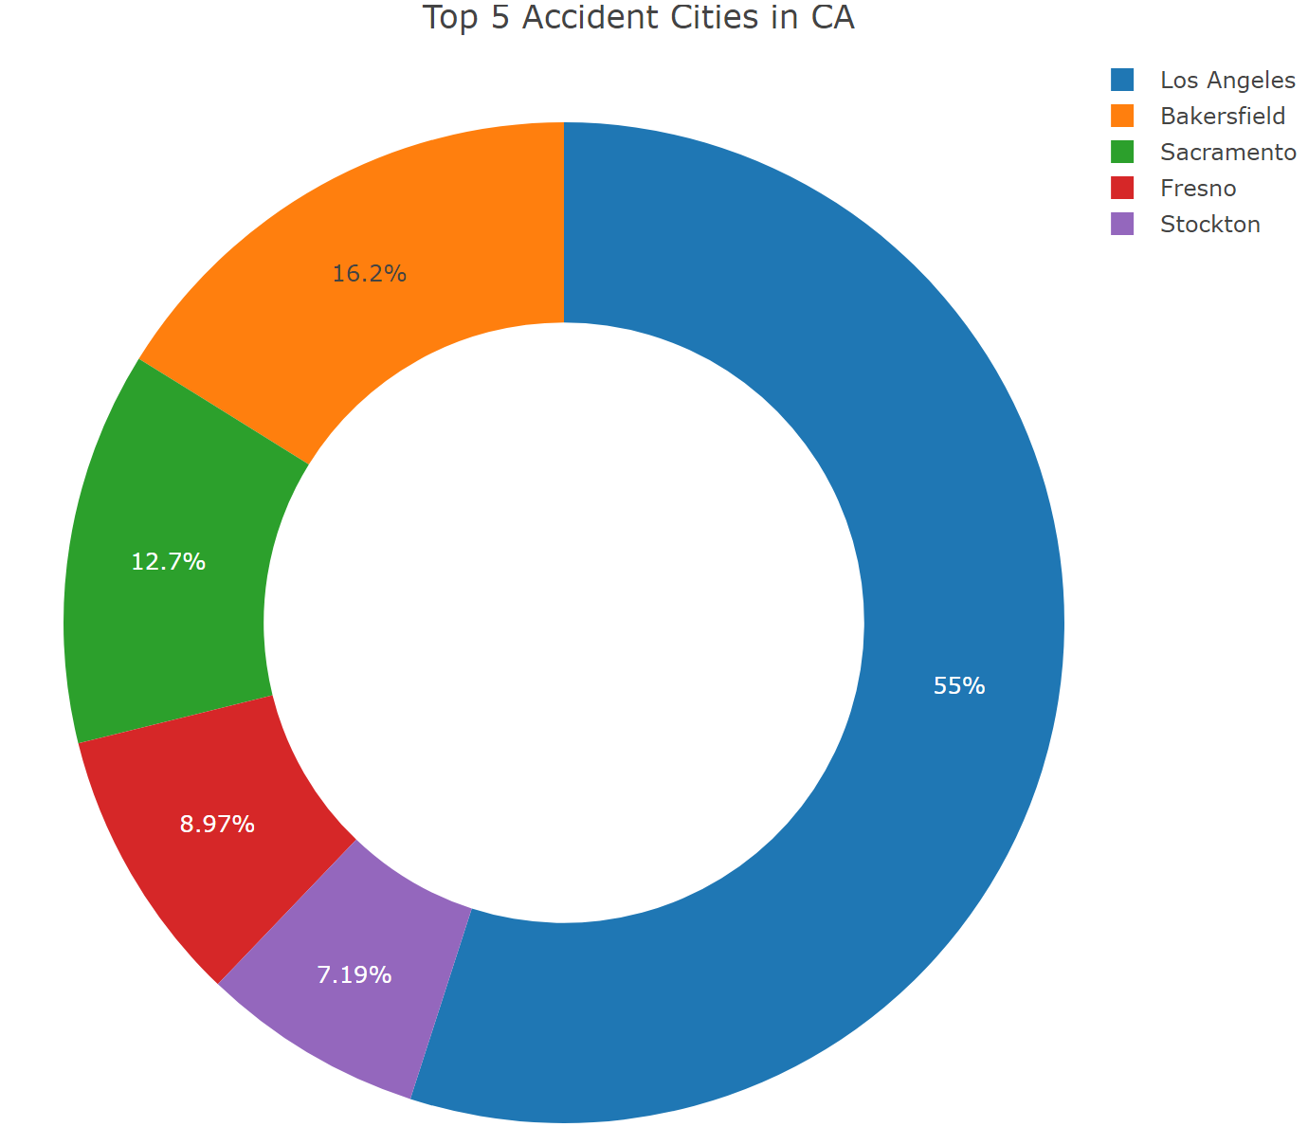
Top 5 accident cities in USA & Top 5 accidents cities in California
Los Angeles is the top city in California with a highest number of accidents and contributes about 55% of all the accidents in California followed by Bakersfield with 16% of the accidents.
From Top 5 accidents cities graph, we observe that most of the accidents are in Houston which is not part of California.

Slide 10
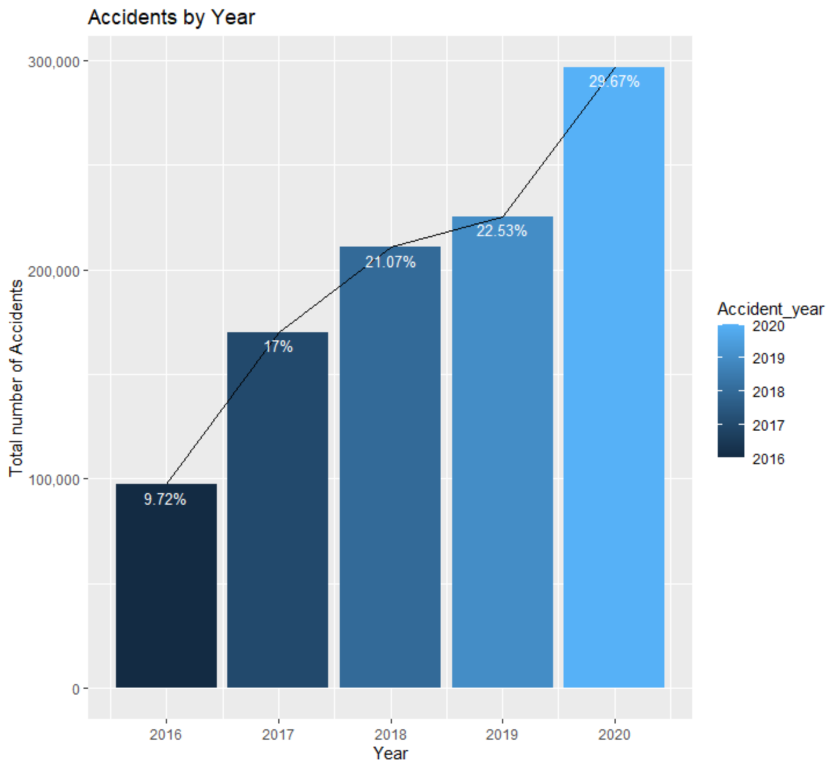
Trend in accidents by year
Number of accidents are increasing every passing year , here we can see that from year 2016 (9.72%) to 2020 (29.67%) there is a 3-fold increase in number of accidents.

Slide 11
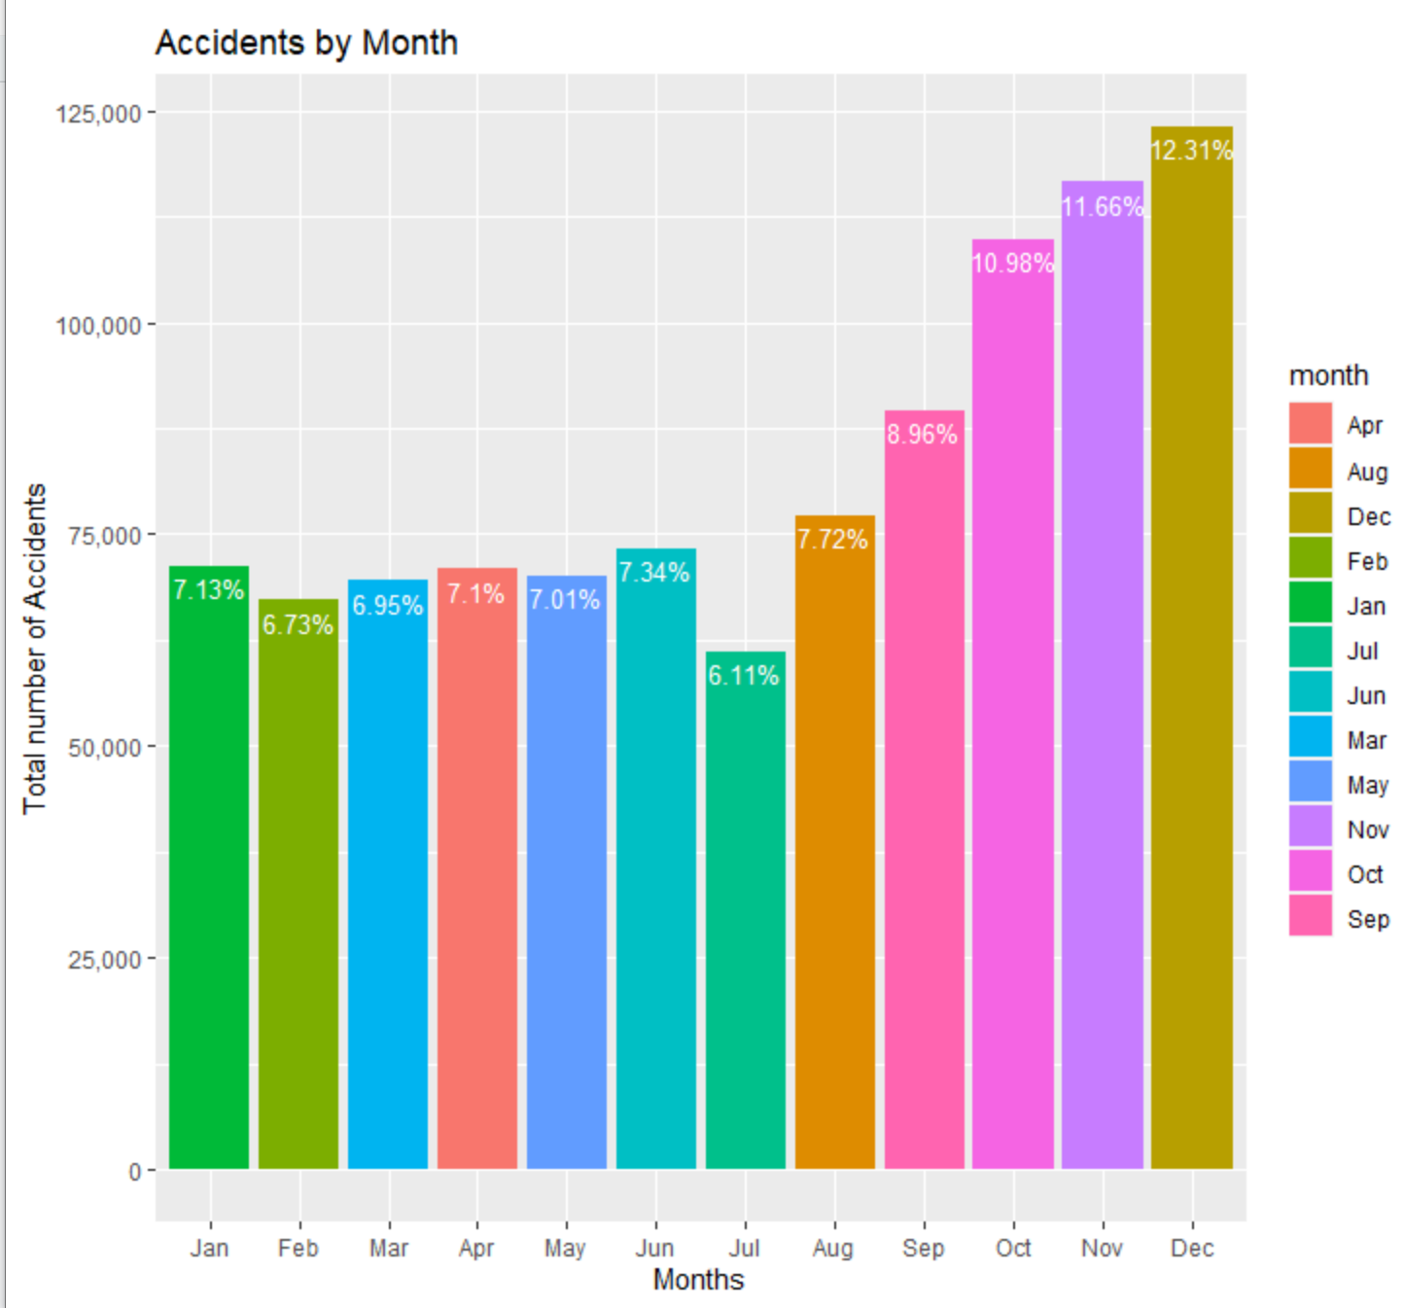
Trend in accidents by Month
This Accident by month chart shows that July (6.11%) has the least percentage of accidents and December (12.31%) has the highest percentage of accidents which is the holiday season in the USA, it is quite surprising that holidays have a significant effect on accidents

Slide 12
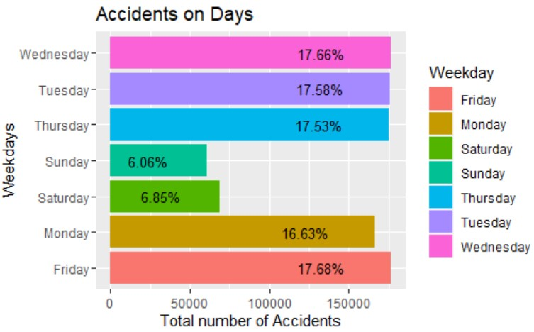
Which days of week have more accidents?
From this accidents on days graph, we can see that most of the accidents tend to happen on weekdays i.e from Monday to Friday

Slide 13
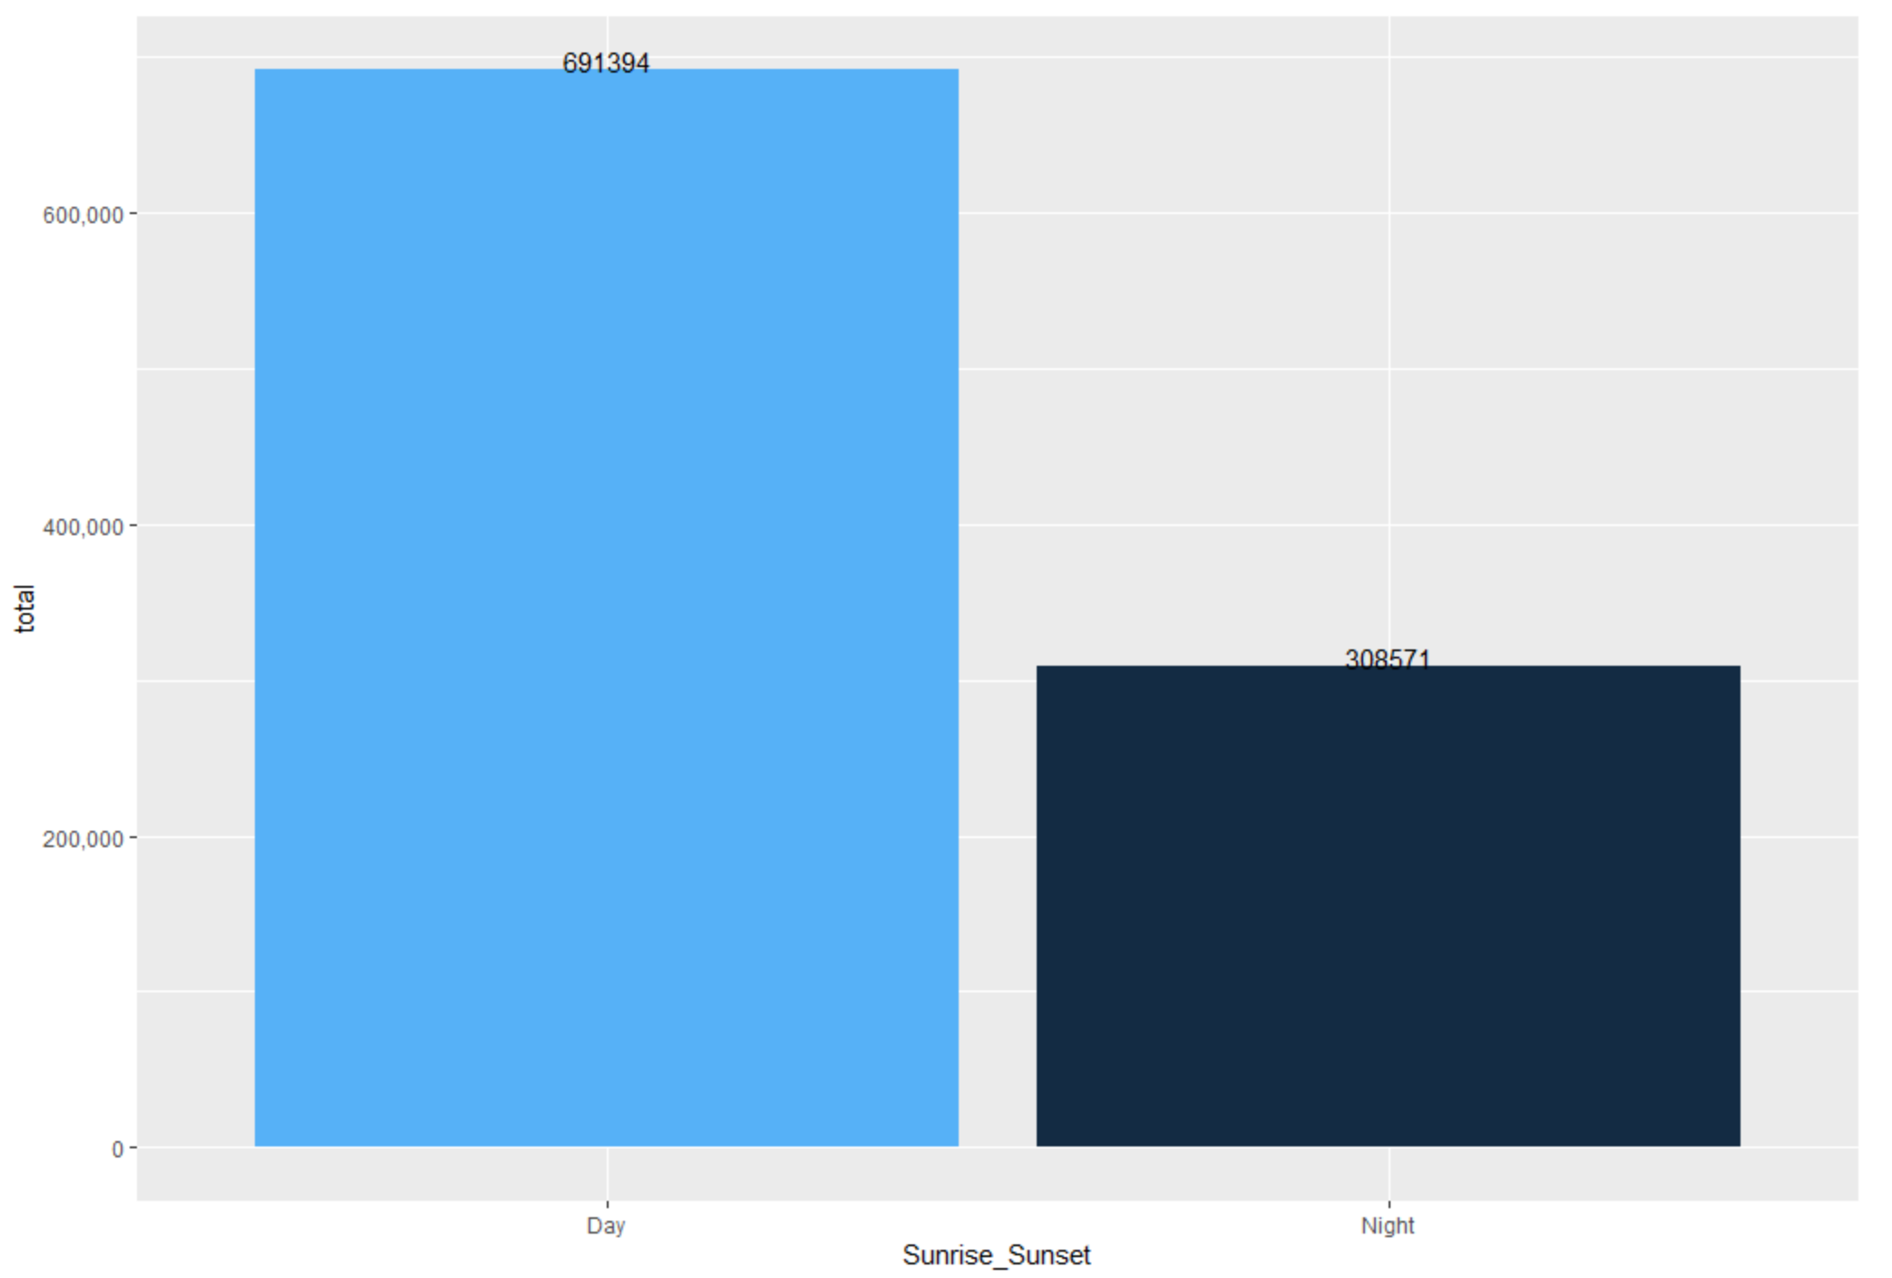
Which part of Day has more accidents?
From the bar graph we can see that most of the accidents occurs in daytime.
One possible reason that we could think of is due to higher commute during day compared to night.

Slide 14
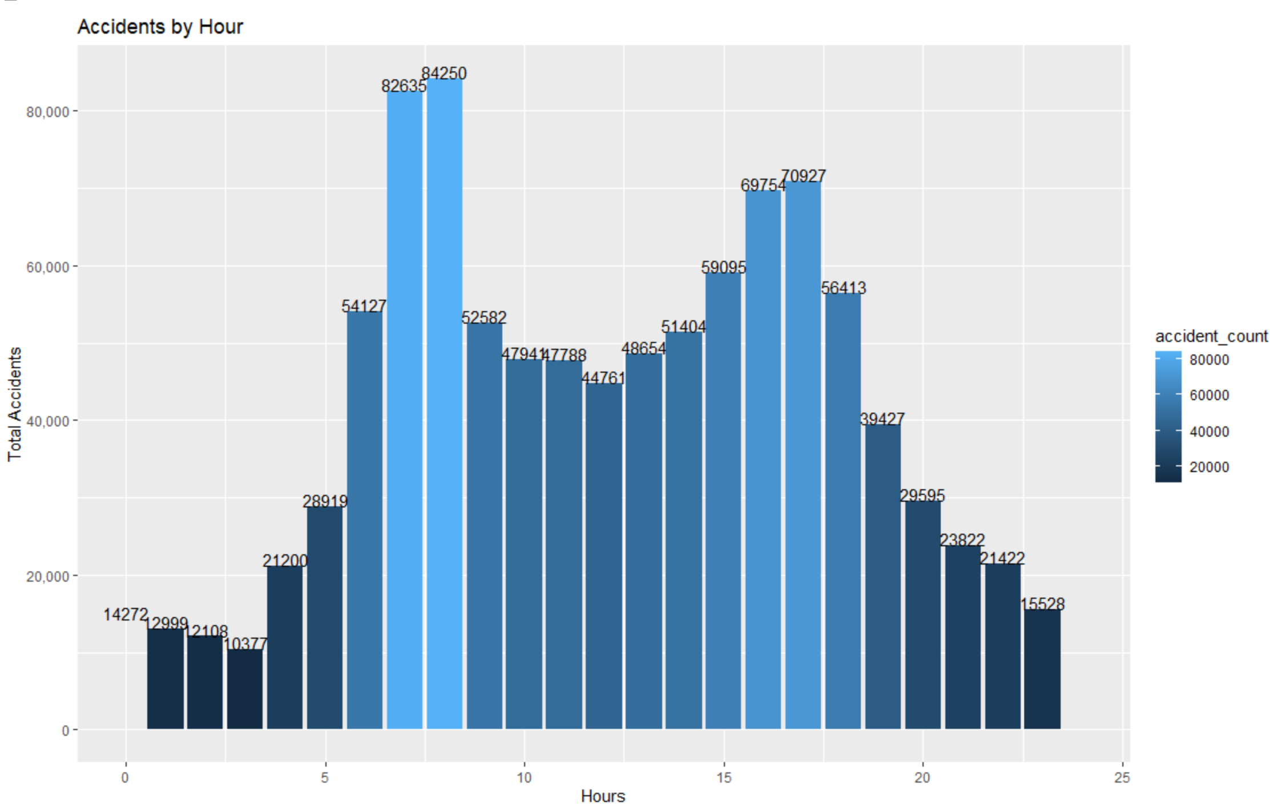
Which time of the day has more accidents?
From the accident by hour graph, we can see that most of the accidents occurs at 7am, 8am, 4pm and 5pm.
One of the reasons could be these are office starting hours and most of the people leave for work and come back from work at these timings.

Slide 15
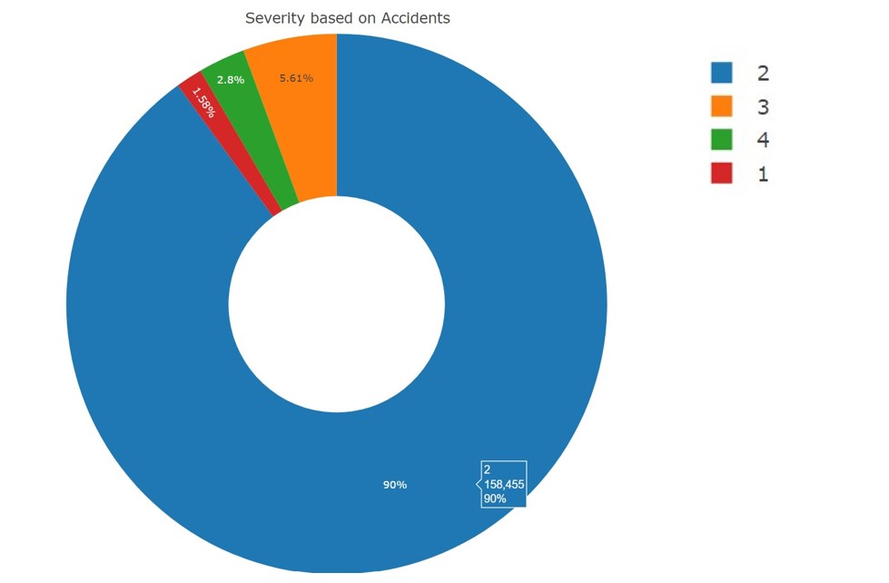
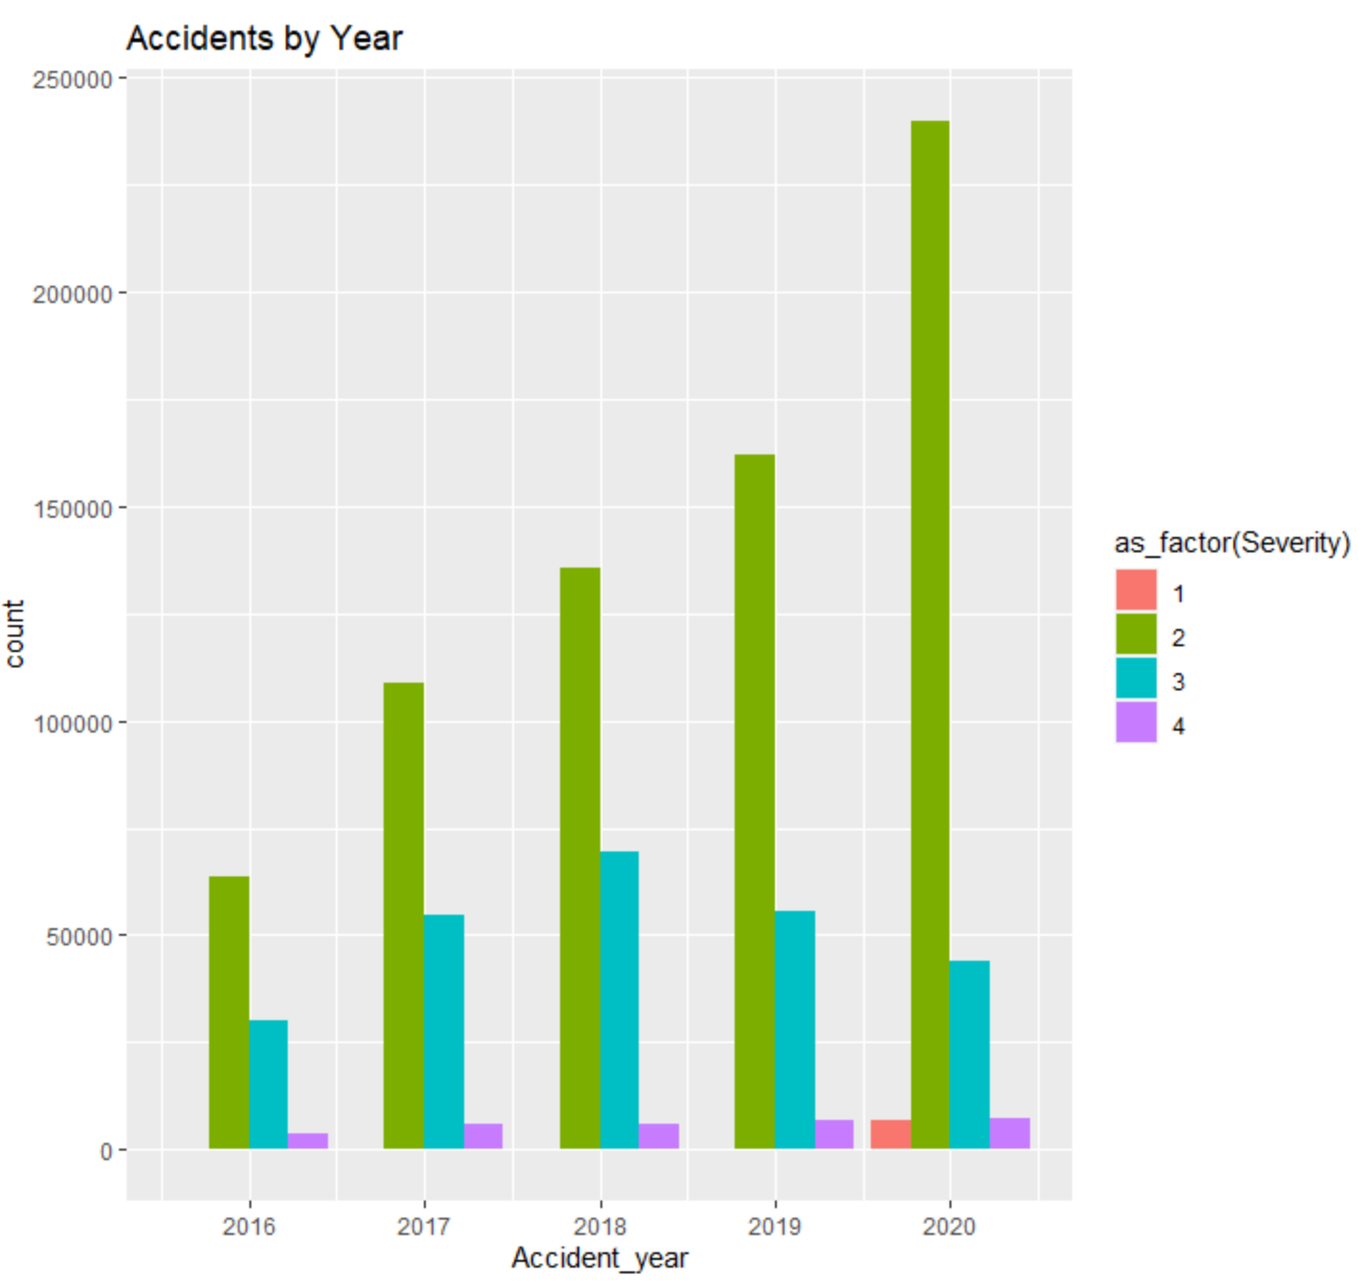
Accidents based on Severity levels
In this dataset severity means how much traffic got affected by accident which means severity 3 and 4 will have higher impact on road traffic when compared with 1 and 2
From severity based on accidents, we see that most of the accidents are of severity level 2 with 90%.

Slide 16
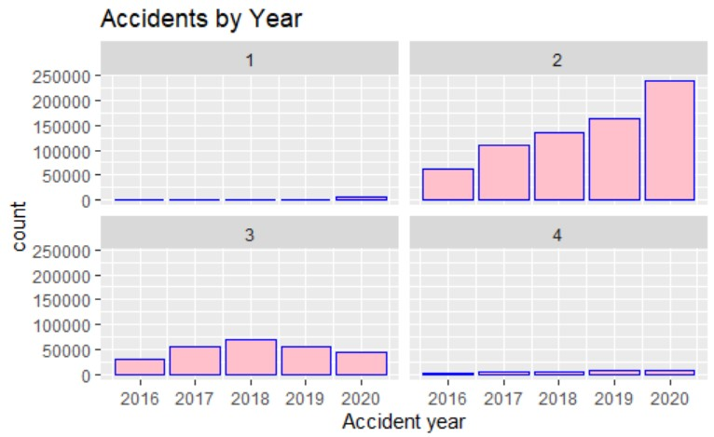
Severity of accidents in different years
Although the number of severity 3 accidents has declined after 2018.
It also shows that majority of the accidents belong to severity 2.
Severity 1 and 4 accidents are rare and have been consistent in number over years

Slide 17
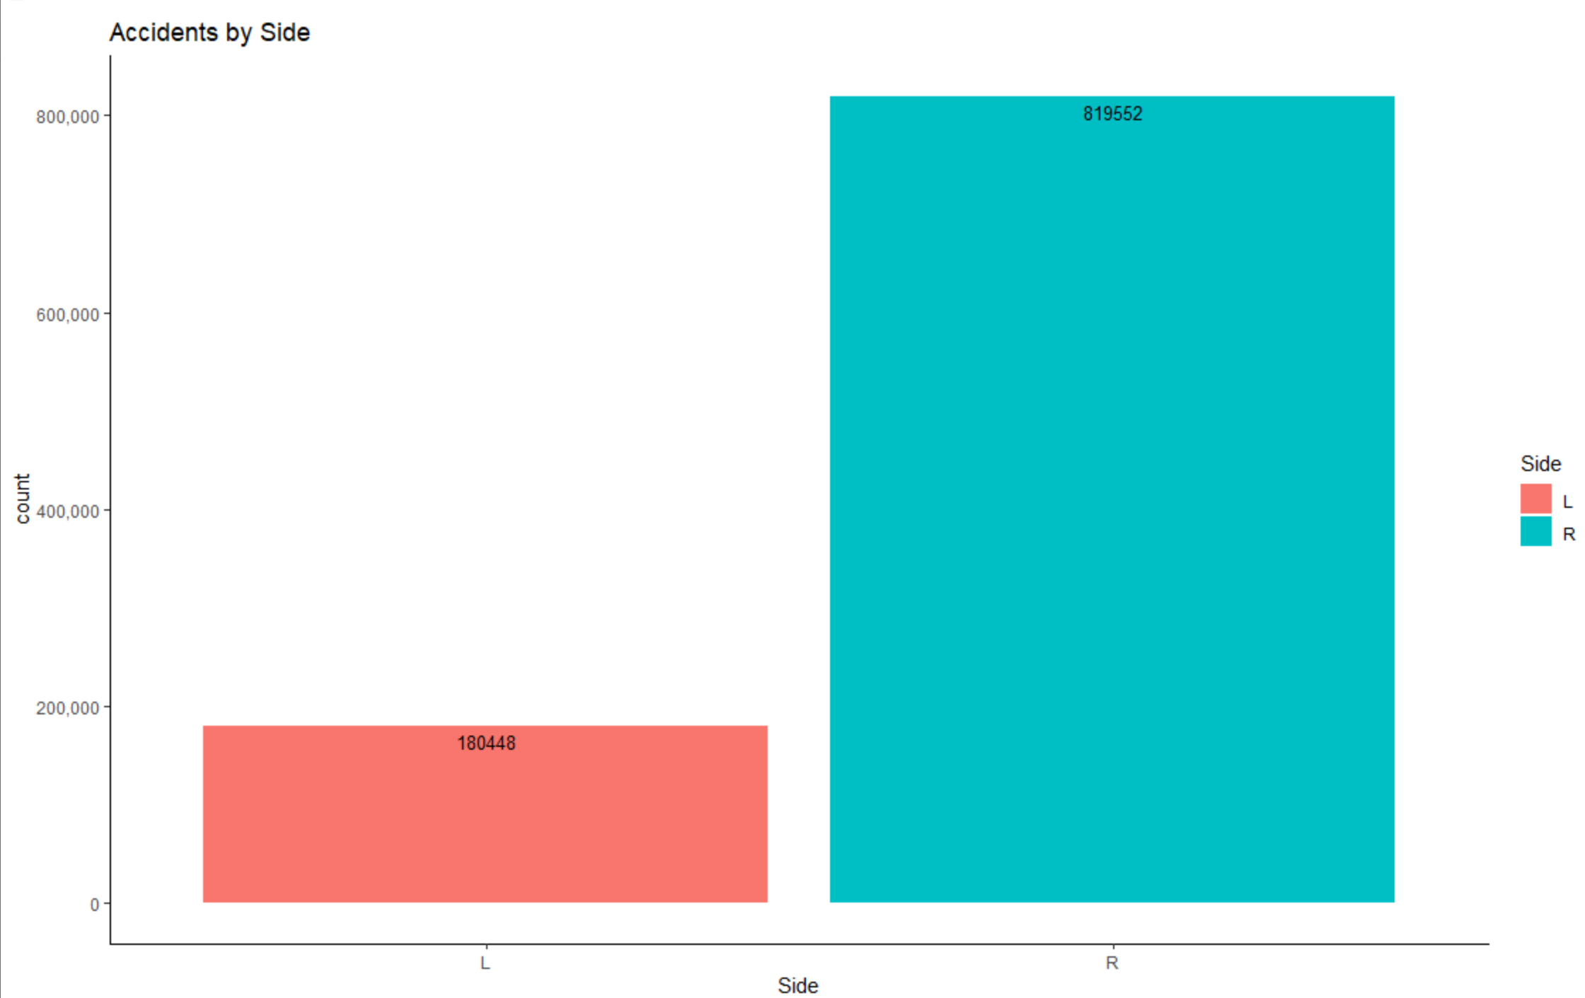
Which Side of the road has more accidents?
This Accident by side graph shows that most of the accidents occurs at the right side with of the road with 819,552 whereas left side has less number of accidents at 180,448.
It is quite surprising because the left most lanes is the fastest one.
One reason for this could be high number of lane merging that vehicles do while entering or exiting the express.

Slide 18
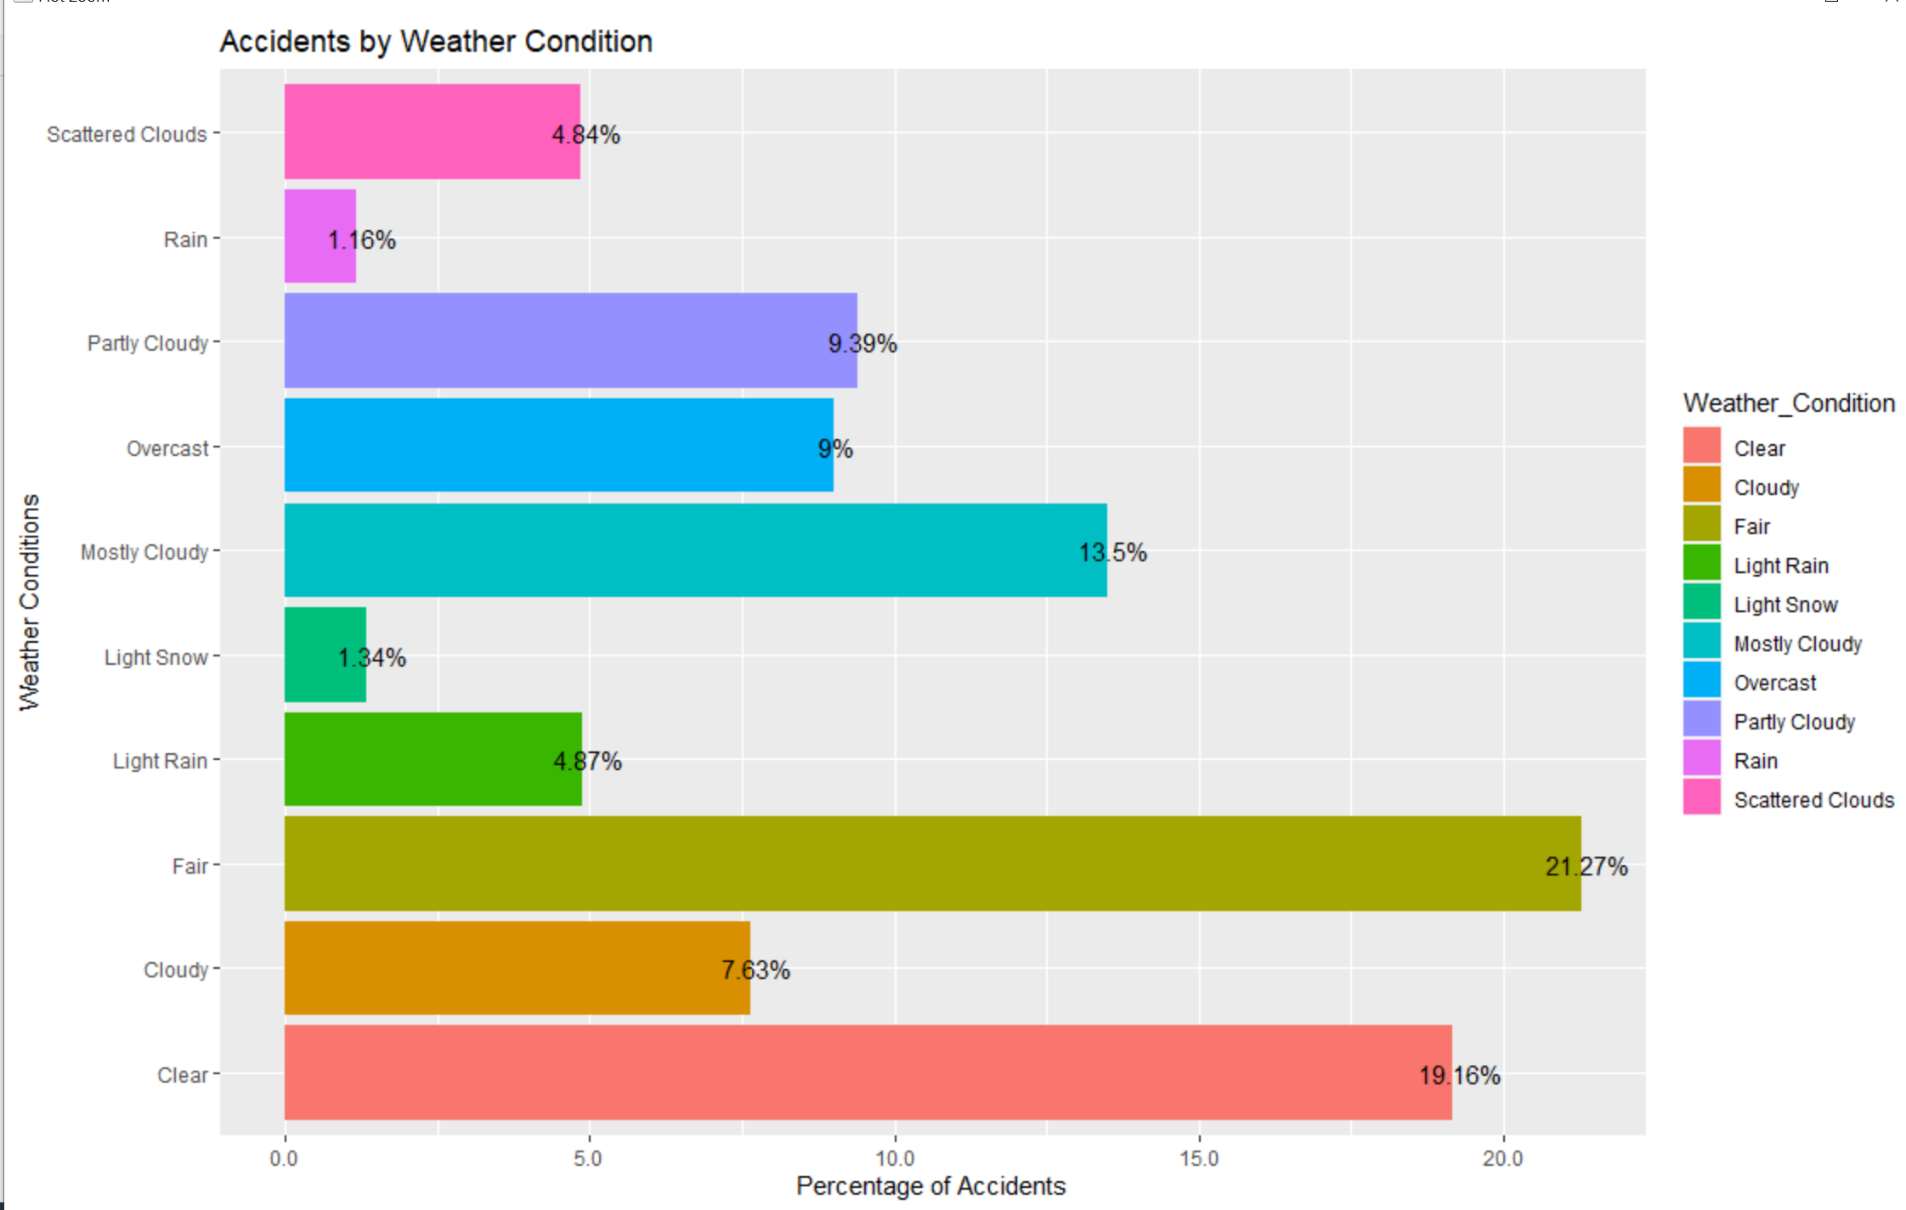
What are the top 10 weather conditions that contribute most of the accidents?
Counter intuitively, most of the accidents appear to occur in fair (21.27%) and clear (19.16%) weather conditions which is approximately 40% of the accidents.

Slide 19
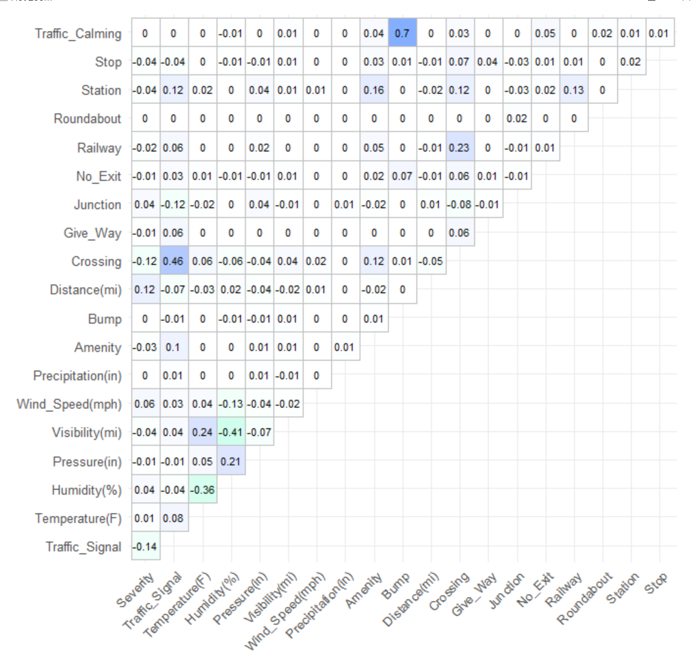
Correlation
From this correlation Metrix we can see that traffic signal and crossing, visibility have negative affect on Severity
It is surprising to see traffic signal and visibility have negative effects on severity of the traffic

Slide 20
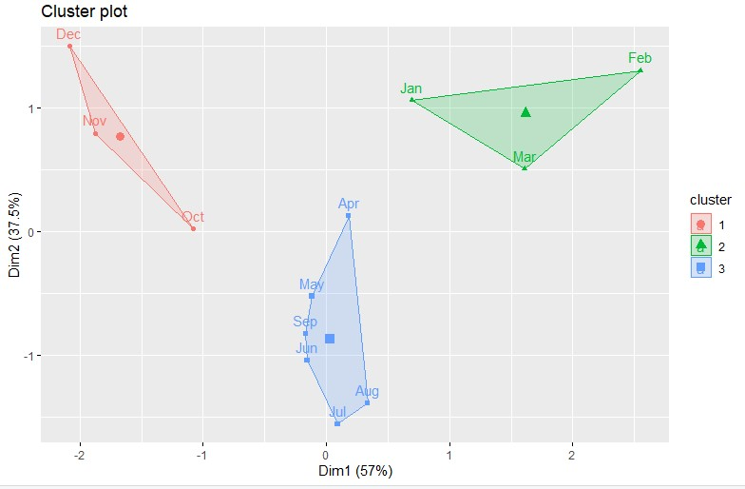
Number of accidents by month based on Precipitation and Temperature
Clustering of months based on Temperature, Precipitation and total number of accidents.
Three methods for determining optimal number of cluster
Elbow method, Average Silhouette method and gap statistic

Slide 21
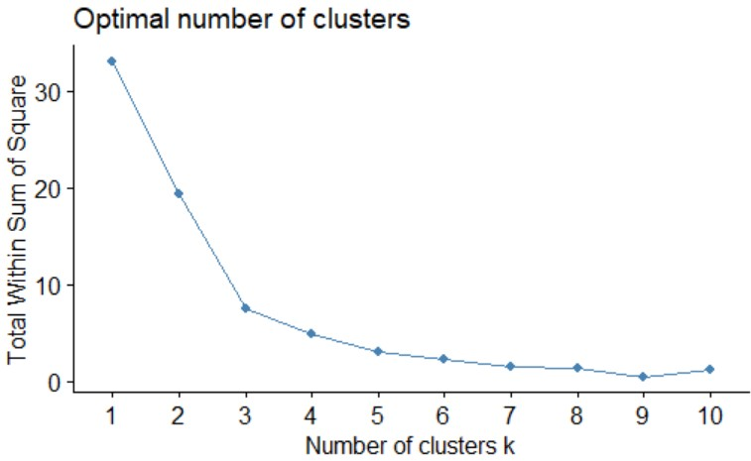
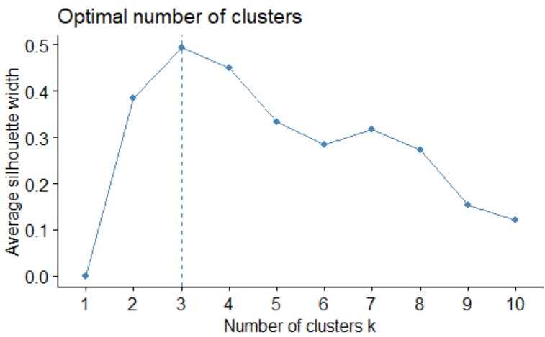
Methods for Optimal number of clusters

Slide 22
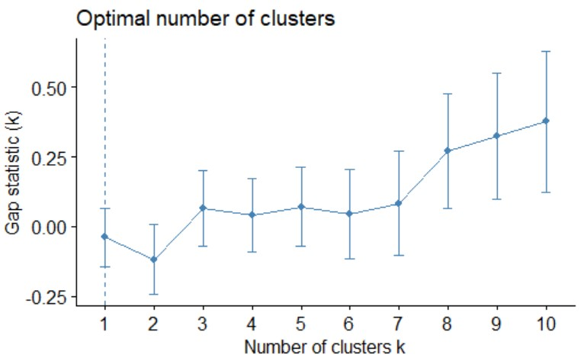
Methods for Optimal number of clusters
Out of three methods, We get 3 as an optimal number of cluster

Slide 23
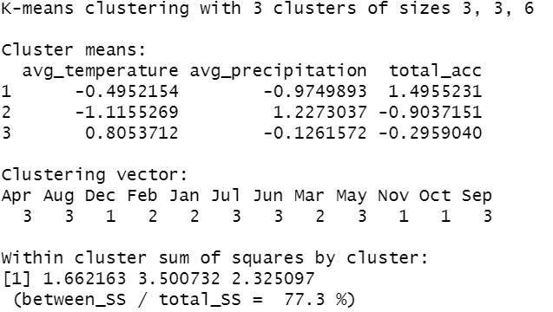
Clustering results
Cluster1 has highest number of accidents
Cluster 2 has highest Precipitation
Cluster 3 has highest temperature
Overall Cluster 1 is more compact than cluster 2 and cluster 3 and has highest number of accidents in October, November and December

Slide 24
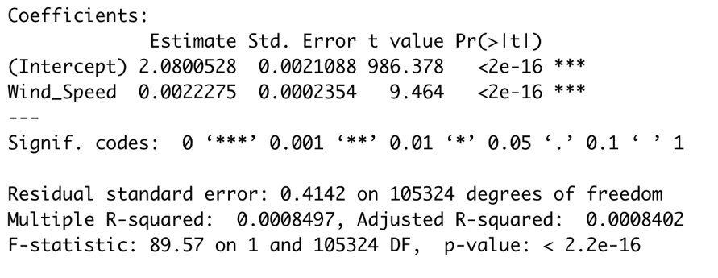
How would you evaluate the impact of wind speed on severity?​
Simple Linear Regression

Slide 25
Results of Linear Regression
According to the analysis of the coefficients, the variable wind speed has a positive value which indicates it’s positive impactness on Severity because an increase of one unit in wind-speed, there is a 0.0022 increase in Severity.​
Moreover, the R-squared and Adjusted R-squared values are not too big, and the F-statistic is 89.57 which shows that it is a good model and a fit one.

Slide 26
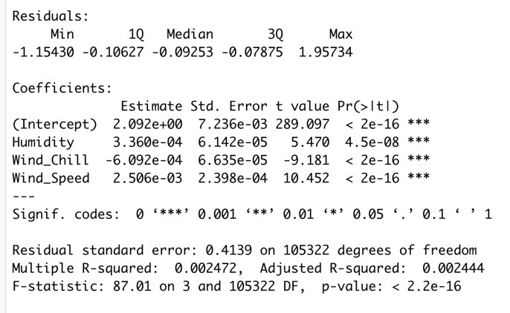
Multiple Regression​ ​ ​
m2<- lm(Severity ~ Humidity + Wind_Chill + Wind_Speed, data = train)​

Slide 27
Results of Multiple Regression
According to the analysis of estimates of coefficients in multiple regression, a one unit increase in humidity, there is a 0.00033 unit of increase in Severity and by one unit of increase in wind speed, there is 0.0025 increase in Severity, whereas this estimate has an inverse relation to wind chill such that, a one unit increase in wind chill, there is a 0.00006 decrease in Severity.​
Additionally, we can observe the coefficients of the variables such that, humidity and windspeed have a positive value which shows a positive impact over the dependent variable, Severity, whereas windchill has a negative impact over the severity of accident. ​
The p-values for humidity and windspeed are less than actual alpha value of 0.05. ​
Finally, the R-squared and Adjusted R-squared values are 24.72 and 24.44 as well as the F-statistic is 87.01 which shows that the model is a fit one.​

Slide 28
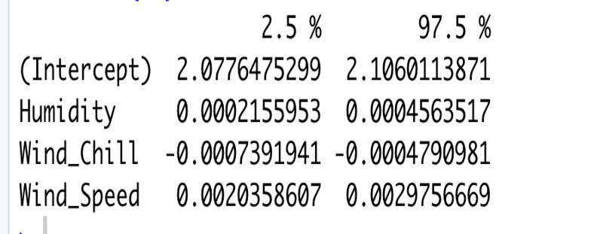
Assessing the confident interval of the model.​

Slide 29
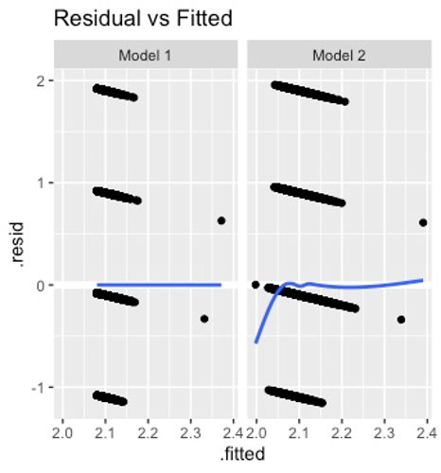
Residual vs Fitted values plot ​ (linearity or non-linearity)

Slide 30
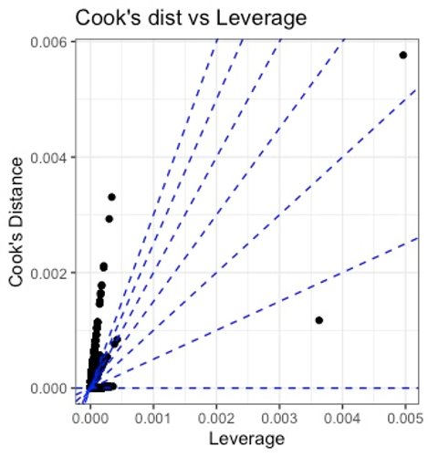
​lot​Cook’s distance and Residual vs Leverage ​
These plots will help us to find the influential cases since not all outliers are influential in linear regression analysis.​
According to the above figure, we can see that our case has a high cook’s distance score on the upper right side of the leverage plot which means it is influential to the regression result and our variable wind speed has higher impact on severity of accidents.​

Slide 31
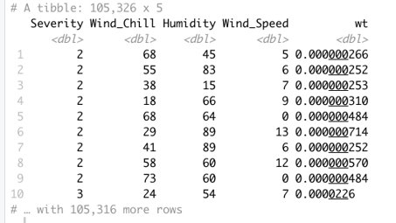
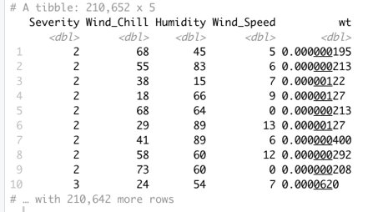
Top observations with the highest Cook's distance​

Slide 32
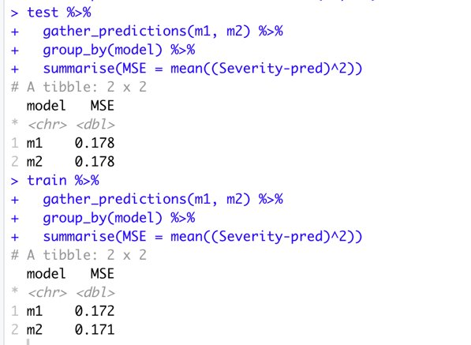
Making predictions​ and MSE for Models
In order to predict which model is more accurate, we need to compare the test sample MSE vs training sample MSE.​
MSE for test sample = 0.178​
MSE for train sample = 0.172​

Slide 33
Summary
Even though the number of low severity and very high severity accidents are almost constant over the years. The severity 2 accidents is sharply increasing resulting in higher total number of accidents.
CA has the highest number of accidents as much as 2.5 times that of TX which is the second in the rank. When we check the cities, Houston has the highest number of accidents. It would be interesting to know what factors contribute sharp decline in number of accidents in Texas considering that TX is twice the size of CA.
Most of the accidents happen during daytime possibly due to high traffic caused by people commuting to the office and back home.
Even though left most lanes is the fastest one, the graph shows that right side of the lane has highest number of accidents. One reason for this could be high number of lane merging that vehicles do while entering or exiting the express.

Slide 34
Summary
Most of the accidents appear to occur in fair and clear weather conditions. It would be interesting to explore the severity of these accidents.
December being the holiday season has the highest number of accidents.
From clustering we came to conclusion that October, November, and December have highest number of accidents
Surprisingly, visibility have no significant affect on severity of accidents.
Humidity and Windspeed have positive impact on severity and wind chill has negative impact.

Slide 35
Recommendation
Increase Road Safety messaging during peak driving hours on weekdays.
Teaching new drivers, the dangers of holiday travel.
Inform on dangers of high visibility driving.
Be more careful in high population areas.
Increase funding to road maintenance.

Slide 36

Questions

Slide 37

This Photo by Unknown Author is licensed under CC BY-NC

